Slide 1
NanoSilver Phosphorus Run
Andrew Scott
Sept 12, 2012

Slide 2
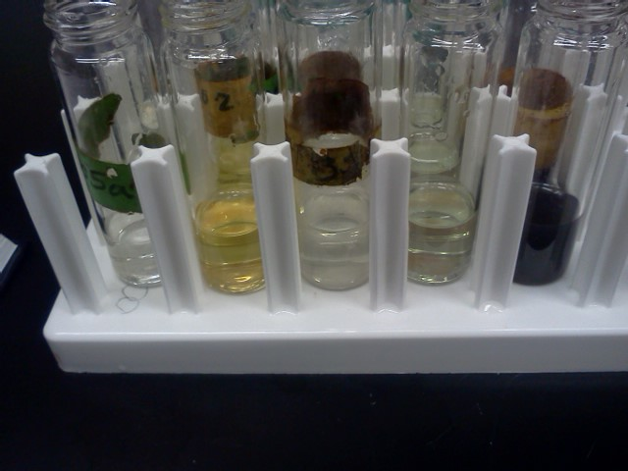
SRP
The two samples on the left are Vive Nano 5ppb and 1500ppb before color reagent
The samples on the right are NanoComposix 10ul, 100ul and 1ml diluted to 10ml
There was interference with the spec

Slide 3
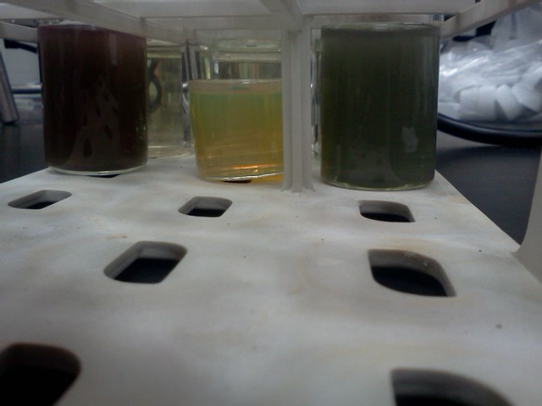
TDP
This is what happened when I added persulfate to the Nano Composix
Middle is without persulfate the sides samples have persulfate. Turned green/purple and murky

Slide 4
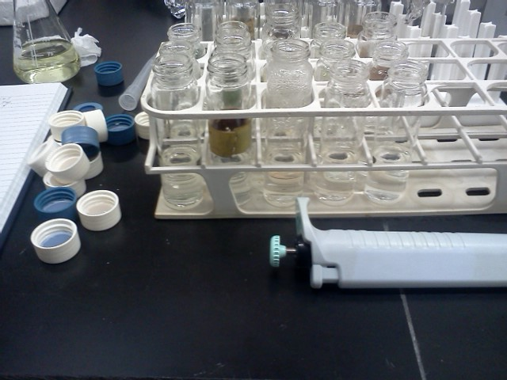
TDP
After autoclave digestion with persulfate all samples were clear. The sample organization is the same as the SRP slide

Slide 5
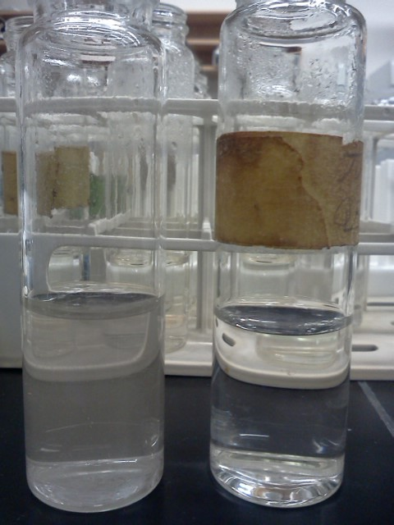
TDP
After adding color reagent the sample turned “silver”. The right vial is with color reagent and both samples are the highest concentration of the NanoComposix
Silver particulates collected onto a 0.2um filter and mostly clarified the sample
The autoclaved sampled without color reagent didn’t have any interference and the abs was 0.000-0.002

